Slide 1
Marketing
Campaign Report
Exploratory Data Analysis

Slide 2
Introduction
This presentation is aim at generating insightful analytics to optimize marketing strategies, by addressing the factors affecting Return on Investment (ROI) and Click-Through Rate (CTR) across different campaigns, companies, and target audiences. By leveraging data visualization and statistical techniques, we aim to identify trends, patterns, and areas for improvement.

Slide 3
Analysis Overview
✅ Identify high-performing campaigns ✅ Analyze factors affecting ROI & CTR ✅ Explore demographic trends ✅ Provide optimization strategies

Slide 4
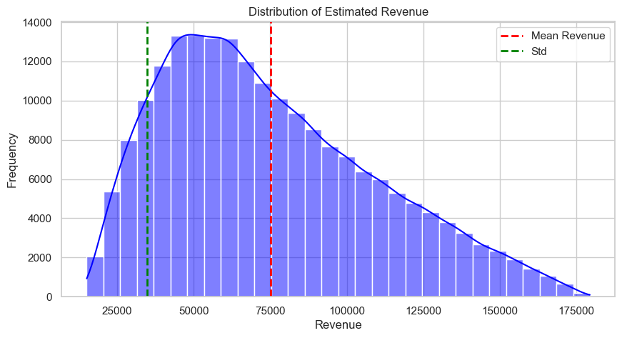
Estimated Revenue Distribution
Given that, Revenue=(ROI × Acquisition Cost) + Acquisition Cost
Insight:
✅ The mean revenue is around $75,000, with a right-skewed distribution.
✅ Majority of revenue falls between $25,000 - $125,000.
✅ Some campaigns achieved $175,000+ revenue, indicating high-potential strategies.

Slide 5
High-Performing Campaigns by ROI & Revenue
Top 5 High-Performing Campaigns
Campaign_ID | Company | Campaign_Type | Channel_Used | ROI | Revenue
182657 | Alpha Innovations | Search | Facebook | 8.0 | 173,250.0
83446 | Alpha Innovations | Search | Email | 8.0 | 170,604.0
47113 | DataTech Solutions | Influencer | Google Ads | 8.0 | 161,721.0
98647 | TechCorp | Search | YouTube | 8.0 | 143,586.0
73037 | NexGen Systems | Email | YouTube | 8.0 | 138,186.0
There are quite a number of high-performing campaign with the peak ROI of 8.0, but the `Campaign ID-182657 (Alpha Innovations)` outpace the others with a `Revenue` of `173250`

Slide 6
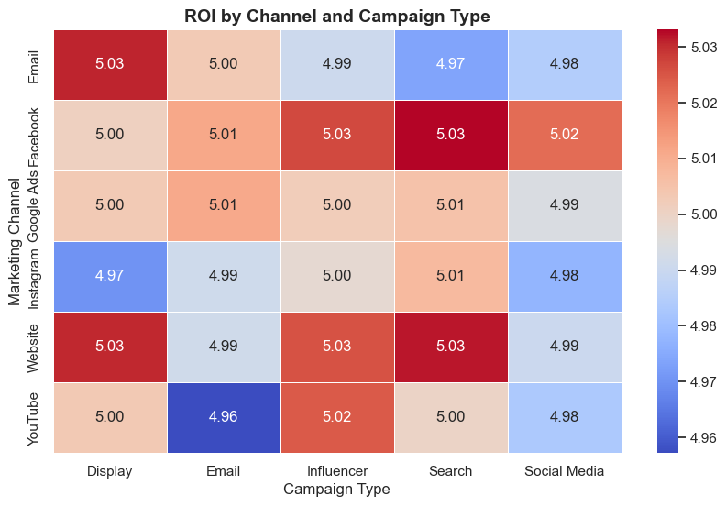
ROI by Marketing Channel & Campaign Type
Insight: ✅ Search & Facebook campaigns had the highest ROI (~5.033). ✅ Unfortunately, Email & YouTube isn’t a good pair (~4.96). 📌On Average, Influencers are overall the most generator of ROI.

Slide 7
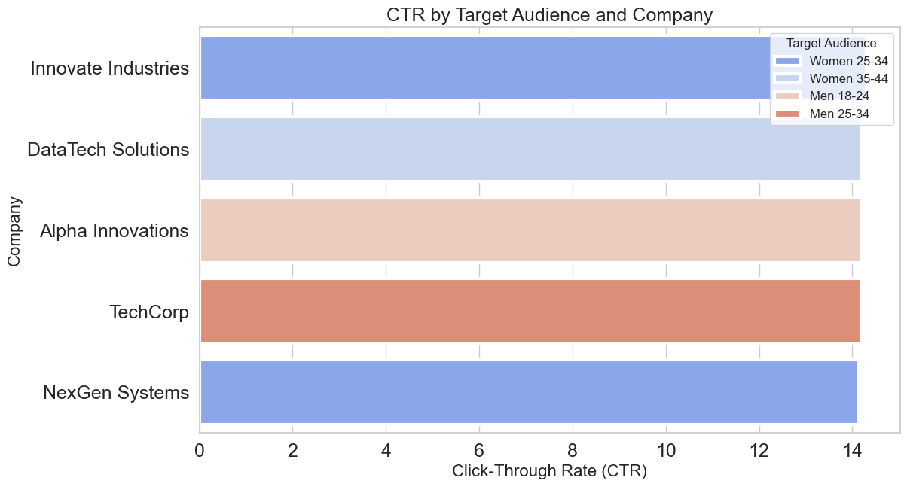
Most Profitable Target Audience for each Company
Insight: ✅Women (25-34 & 35-44) have the highest CTR (14.30% & 14.20%), suggesting they are more responsive to marketing campaigns than men. ✅Innovate Industries has the highest CTR (14.30%), meaning its campaigns resonate best with the target audience.
✅CTR is slightly higher for younger men (14.19%) than older men (14.18%)

Slide 8
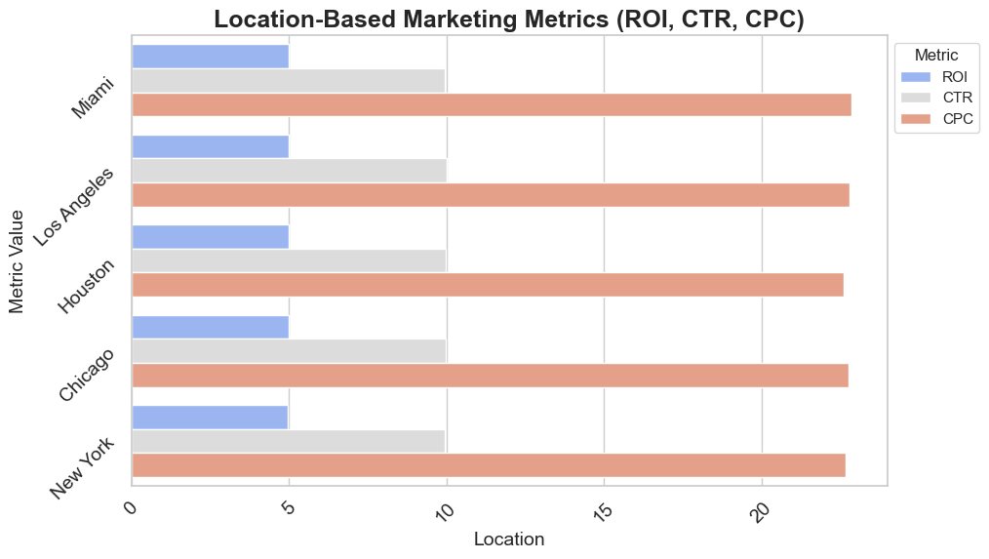
Explore demographic trends
Insight: ✅ The CTR hovers around 10%, suggesting effective ad engagement ✅Miami and Los Angeles have the highest ROI (~5.01), indicating better returns on investment for marketing campaigns in these cities.
New York has the highest conversion rate (0.080203), meaning more people complete the desired action after clicking the ad.

Slide 9
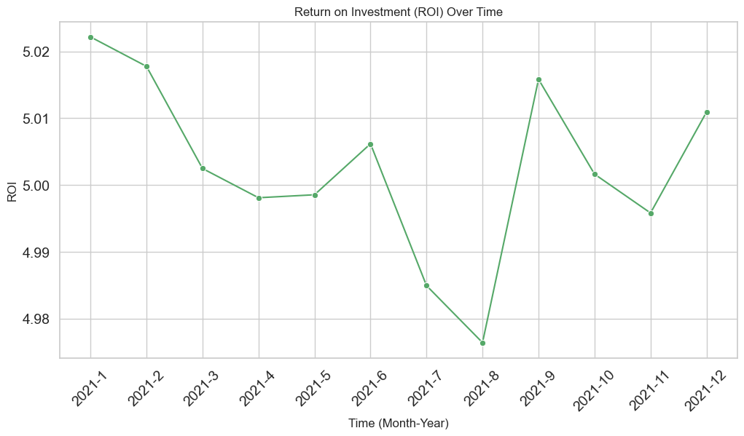
Market Trend - Return On Investment (ROI)
Insight: ✅A sharp spike in ROI is observed in September 2021, reaching above 5.02.
Possible reasons:
High-performing campaigns or product launches.
Optimized ad targeting or reduced costs.
The highest ROI is observed in January and September 2021, while the lowest occurs around August 2021.

Slide 10
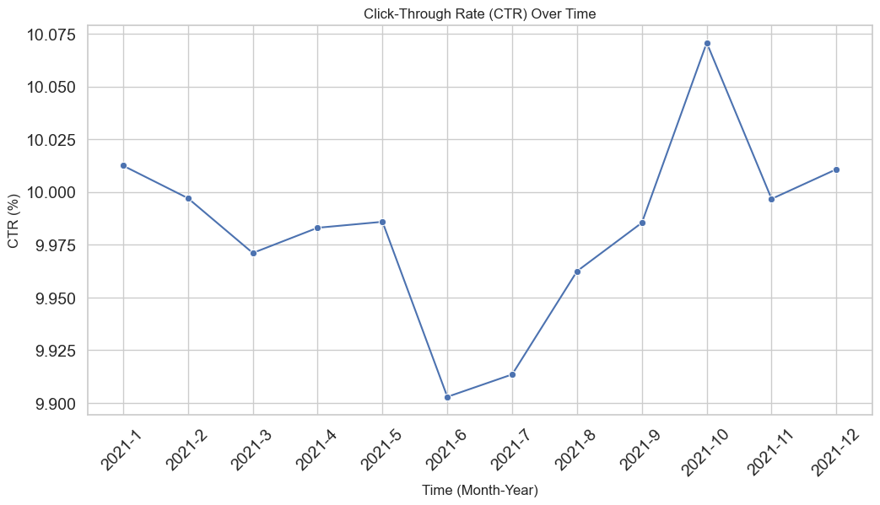
Market Trend - Click Through Rate (CTR)
Insight: ✅Initial Decline (January - June 2021) reaching the lowest point (~9.90%) in June.
✅Sharp Recovery (July - October 2021) reaching its highest (~10.07%) in October.
This suggests:
Improved engagement through better creatives & messaging.
Increased seasonal demand.

Slide 11
Recommendations Based on Analysis
Increase Investment in High-ROI Campaigns
Campaigns with an ROI above 5.0 should receive higher budget allocation as they demonstrate strong returns.
Reduce spending on campaigns with an ROI below 2.0, as they may not be cost-effective.
Enhance Click-Through Rate (CTR) with Better Targeting
Campaigns with CTR above 10% indicate high engagement and should be expanded to similar audience segments.
Refine Location-Based Marketing Strategies
Cities like Miami and Los Angeles had the highest CTR (~10%) and ROI (~5.0+), indicating strong audience engagement.
Locations with lower CTR (<7%) need more localized content or different targeting approaches.
Target High-Performing Demographics More Effectively
Campaigns targeting Women 25-34 and Men 18-24 had the highest CTR (~14%), making them ideal segments for expansion.
Age groups or demographics with lower engagement should be re-evaluated for content relevance and platform suitability.

Slide 12
Conclusion
This analysis provided valuable insights into key performance metrics such as ROI, CTR, CPC, and conversion rates, helping identify high-performing campaigns, audience segments, and locations. By leveraging data-driven strategies, businesses can optimize marketing spend, refine audience targeting, and maximize returns.
The findings emphasize the importance of investing in top-performing campaigns, reallocating budget based on ROI, and continuously optimizing ad creatives and bidding strategies. Locations and demographics with higher engagement and conversion rates should be prioritized, while underperforming campaigns require strategic adjustments.

Slide 13
Thank you.

